Slide 1
Using Data:
A Micro Agency’s Perspective
Nicole Stein

Slide 2
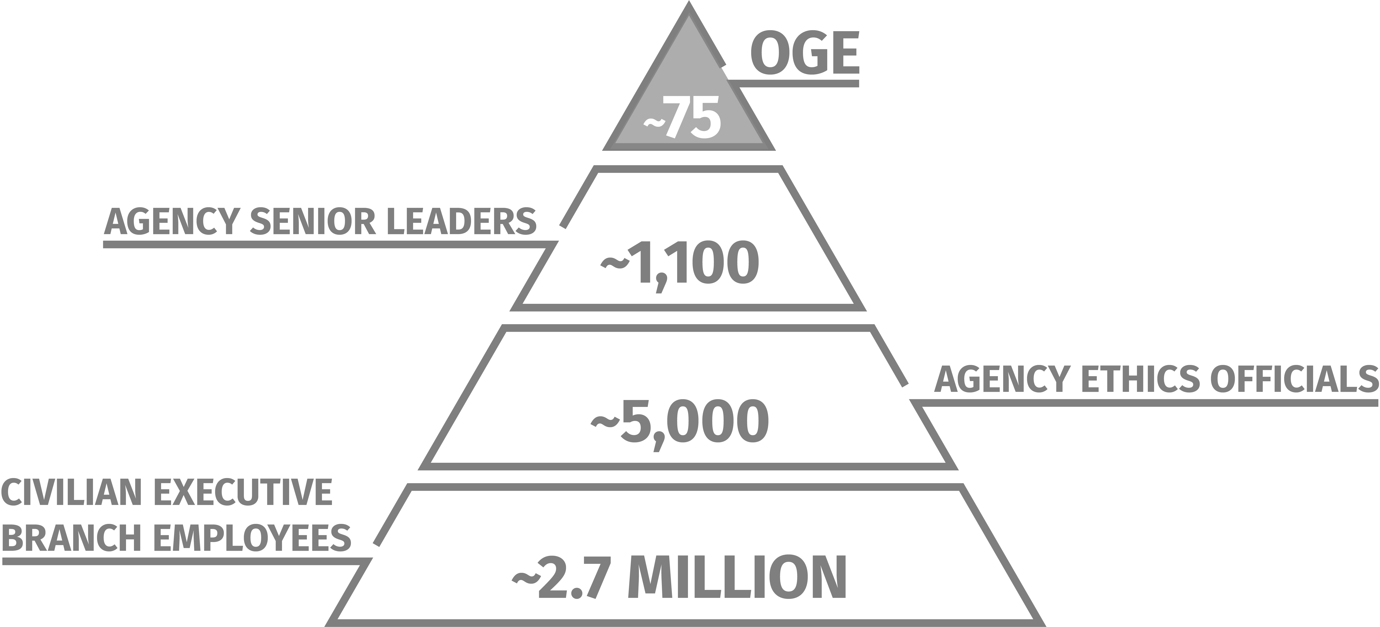
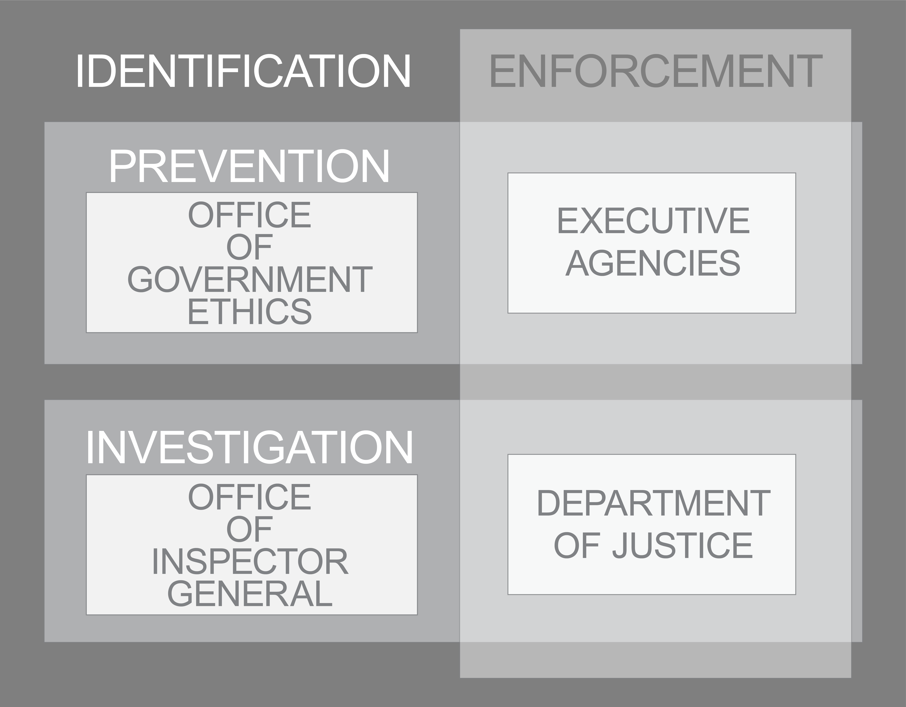
THE EXECUTIVE BRANCH ETHICS PROGRAM IS DECENTRALIZED
PREVENTING, INVESTIGATING, & ENFORCING ETHICS ISSUES IS SHARED WORK

Slide 3
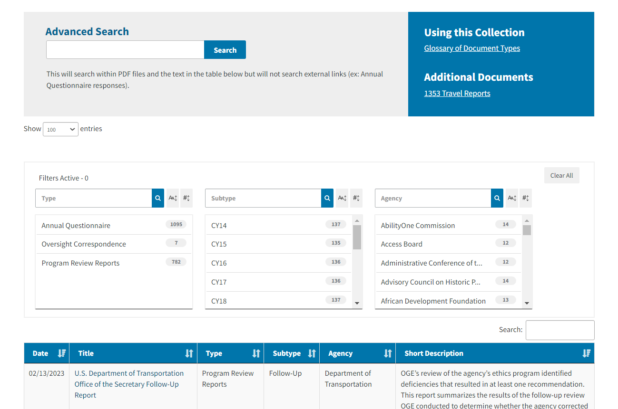
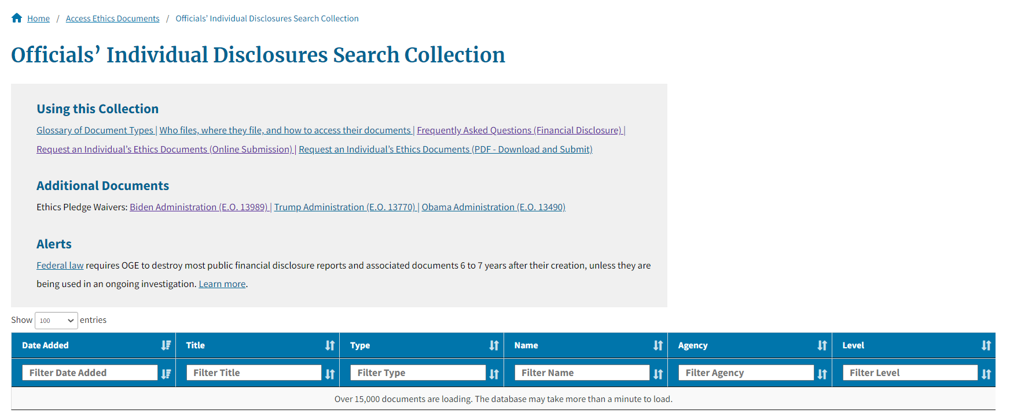
Use of Data to Build Public Trust

Slide 4
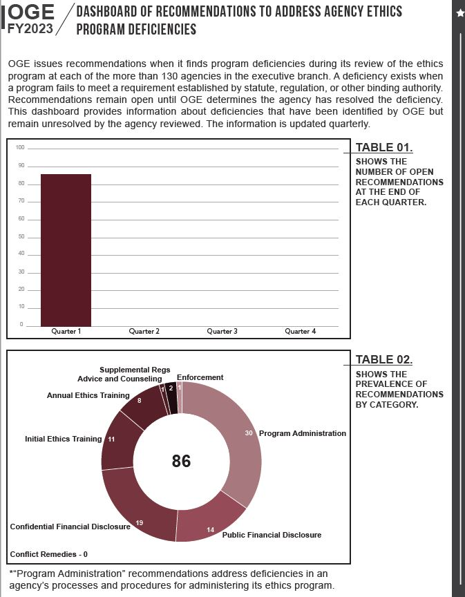
Use of Data to Oversee the Executive Branch Ethics Program

Slide 5
Use of Data to Inform Agency Decisions
Staffing/Assignments
Advisory Topics
Proactive Outreach
Performance numbers

Slide 6
?
QUESTIONS

