Slide 1
Technology Insights:
A Brief on Data Security Posture Management
Presented by Orca Security
February 2023

Slide 2
What is Data Security Posture Management (DSPM)?
“Data security posture management (DSPM) provides visibility as to where sensitive data is, who has access to that data, how it has been used and what the security posture of the data store or application is.”
Source: Gartner, Hype Cycle for Data Security, 2022 - August 2022
DSPM tools must enable security teams to:
Know where sensitive data resides
Discover and eliminate shadow data
Address misconfigurations, excessive privileges, and other risks
Maintain continuous compliance
Notes:
Yet with continued API adoption in recent years, come with the rise in threats from cyber attackers or human error leading to misuse.
You see the Gartner quote here on the screen - here’s a few other to note:
Apart from the threats themselves, just knowing which APIs are in your cloud workloads is complicated. Given the pace of cloud-based application development, it’s almost impossible to keep track of new and changed APIs. Application complexity leads to misconfigurations, as well as unmanaged and unsecured APIs that create vulnerabilities. In fact, Gartner predicts that by 2025, less than 50% of enterprise APIs will be managed. API Security, therefore, is greatly increasing in importance.
Why are some APIs unmanaged? The two main reasons for APIs escaping management and security policies are the following:
Zombie APIs When newer APIs are produced, previous APIs are almost never decommissioned. Even though these APIs might have been managed previously, they can quickly become neglected and forgotten.
Shadow APIs - Shadow IT is the use of information technology systems, devices, software, applications, and services without IT department approval and visibility. For instance, if developers implement APIs without notifying IT, this can lead to APIs remaining ‘hidden’ from security teams.

Slide 3
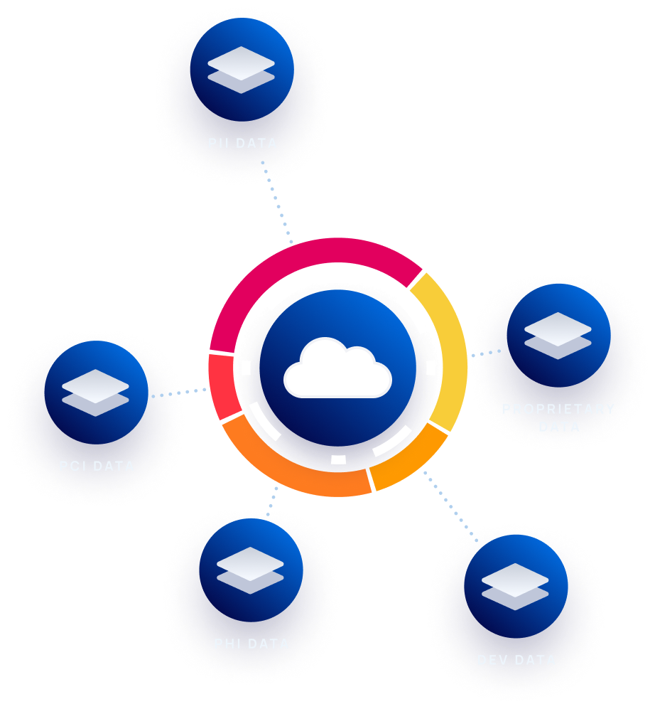
Terminology
Managed by the cloud providers - AWS RDS, Azure SQL, etc.
Types of
Data Stores
Unmanaged (customer-maintained) - MongoDB, MySQL, etc.
3rd parties - Snowflake, Databricks, etc.
“Shadow data” managed by no one - csv, eml, backups, etc.
Regulated data - PII, PHI, PCI, etc.
Types of
Sensitive Data
Secrets - passwords, keys, etc.
Custom - intellectual property, patents, business strategic decisions, etc.

Slide 4
Organizations Lack Confidence in Sensitive Data Protection in the Cloud
Confidence in organization’s ability to protect sensitive data in the cloud
“The amount of sensitive classified data in public clouds is expected to nearly double over the next 24 months, yet more than half of organizations believe notable portions of their sensitive data stored in public cloud services is insufficiently secured.”
6%
19%
31%
44%
- ESG (March 2022)
Graph source - “Sensitive Data in the Cloud” - Cloud Security Alliance (July 2022)
Note: DSPM is not limited to only cloud ecosystems, it should be taken as an enterprise-wide approach including on-prem, workstations, and mobile
Notes:
The amount of data is the cloud is double once in a 24 months
The amount of places that data can be stored in the cloud is enormous - Managed/UnManaged- DBs, files,
Mention what is sensitive data

Slide 5
Organizational DSPM Challenges
Data is scattered across multiple CSPs
Cloud Data Security Challenges
Data stores comes in many different forms (managed and unmanaged databases, CSV files, etc.)
Identifying shadow data
Weak or incomplete visibility into PII, PHI, and PCI data
Current Cloud Data Security Tools Are Lacking
Lack insight into the wider context of cloud risks, weakening risk prioritization
Limited data discovery and/or classification
DLP tools were not built for the cloud
Requiring additional tools or integrations for DSPM telemetry

Slide 6
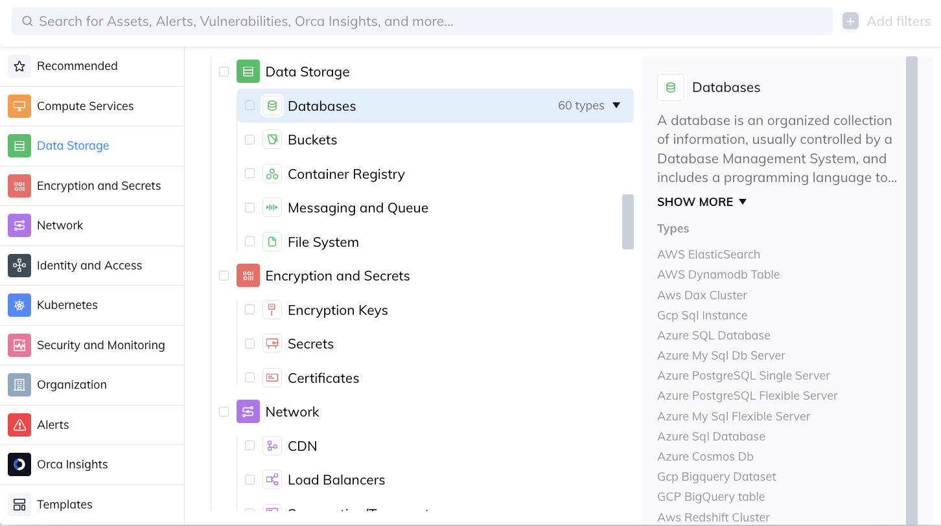
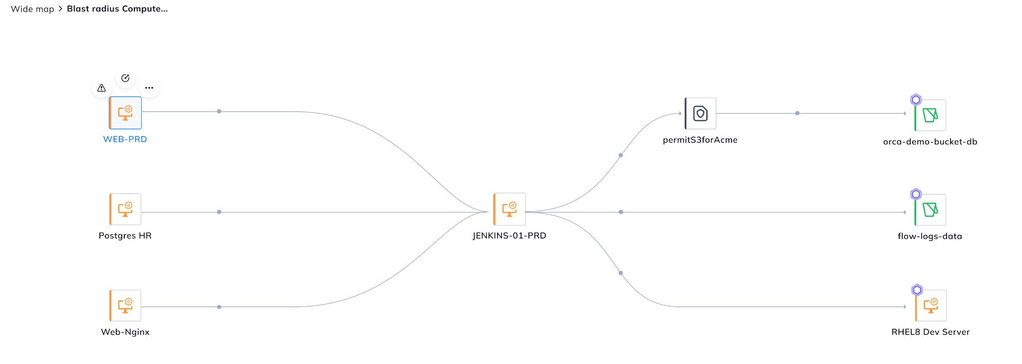
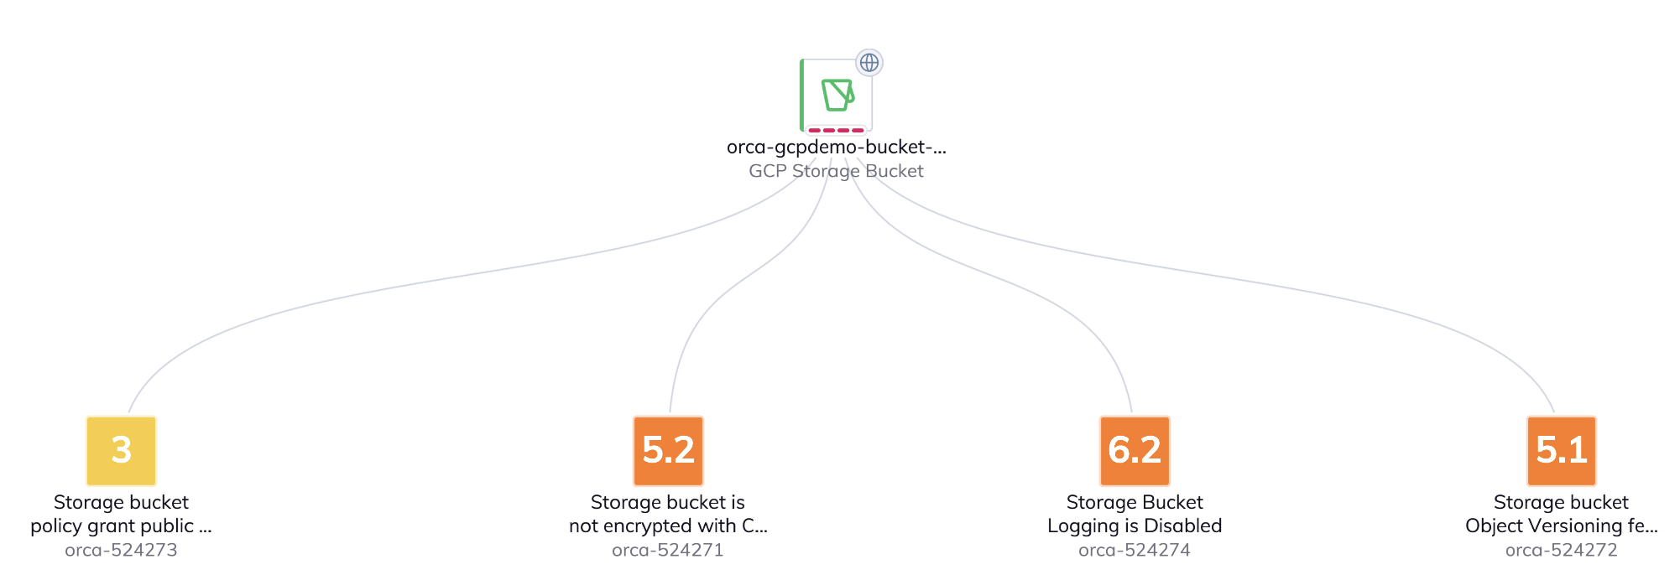
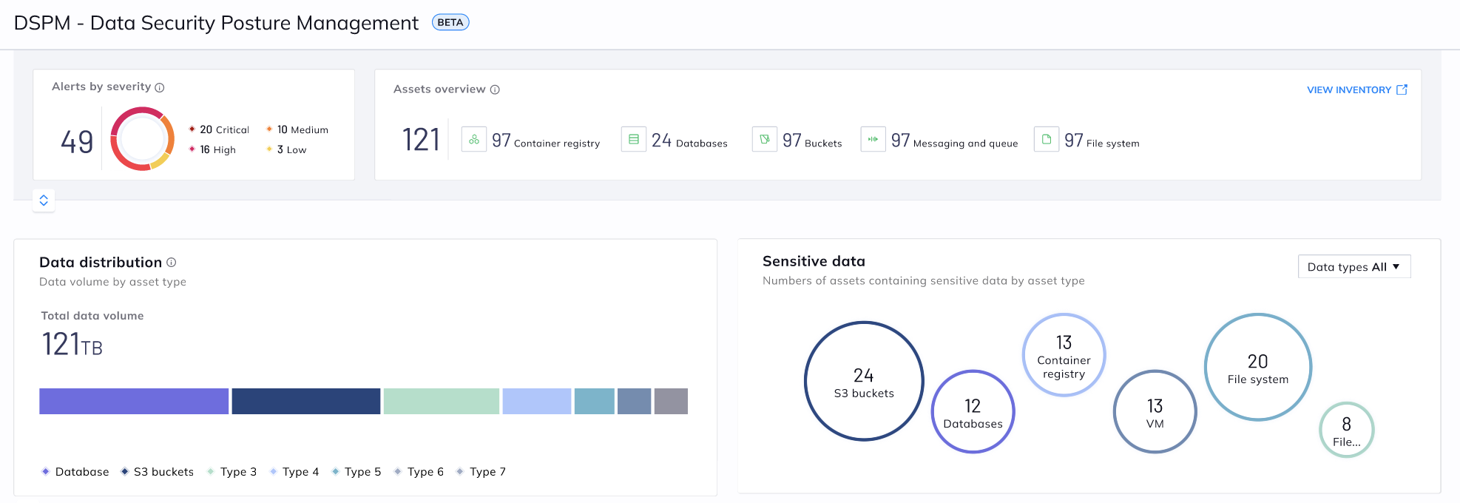
Cloud Data Security challenges from the security practitioner perspective
Where is my sensitive data reside?
Who is accessing my data?
How my data is being used?
What is the security posture of data stores?
Data is scattered across multiple CSPs and data stores
Hackers / insider threat / misconfiguration
Understand the organization workflow to reduce false positives (for example, PCI VPC)
Identify sensitive data crown jewels and maintain continuous compliance

Slide 7
Quick Start
Data Security Posture Management Program
Understand your data
Identify where your data is stored across your cloud ecosystem (SaaS, IaaS, PaaS, APIs, repositories, etc.)
Determine the type of data: Regulated, Intellectual Property, Structured/Unstructured, Sensitive, Passwords, Keys, etc.
Define data context and classification schema (what’s important and why)
Prioritization
Determine data management processes aligned to your classification and risk tolerance
Know your attack surface
Identify areas to reduce or eliminate data collection
Determine how sensitive data is being used and by who
Monitoring
Know your data inventory
Detect who is accessing sensitive data
Understand changes and modifications of the data
Monitor data access policies for violations

Slide 8
About Orca Security

Slide 9
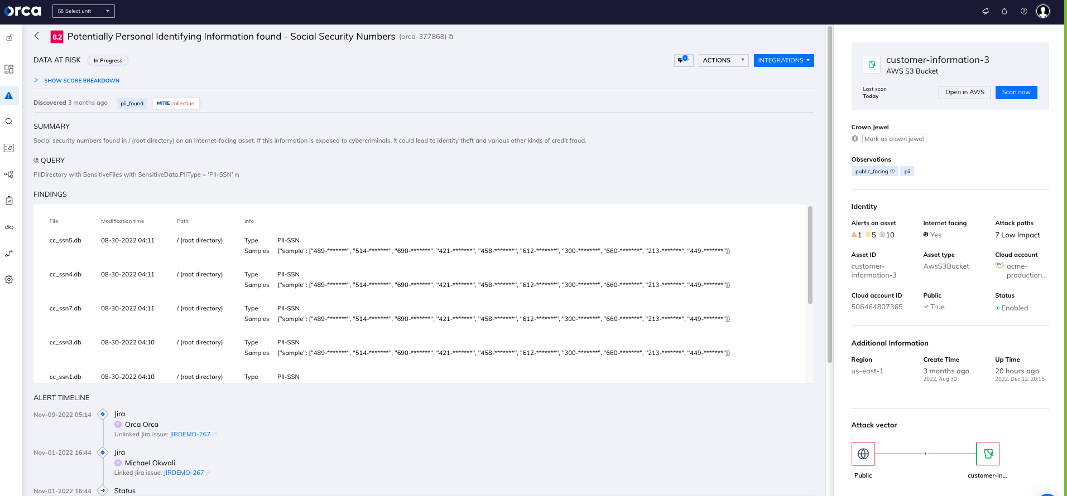
Orca Has Provided Visibility into Cloud Data Protection …from the Start!
Long before Gartner came out with the name ‘DSPM’, Orca was able to:
Scan files on VMs, buckets, and containers
Identify PII and Crown Jewels
Prevent sensitive data exposure by addressing misconfigurations, excessive privileges, and other risks
Support compliance

Slide 10
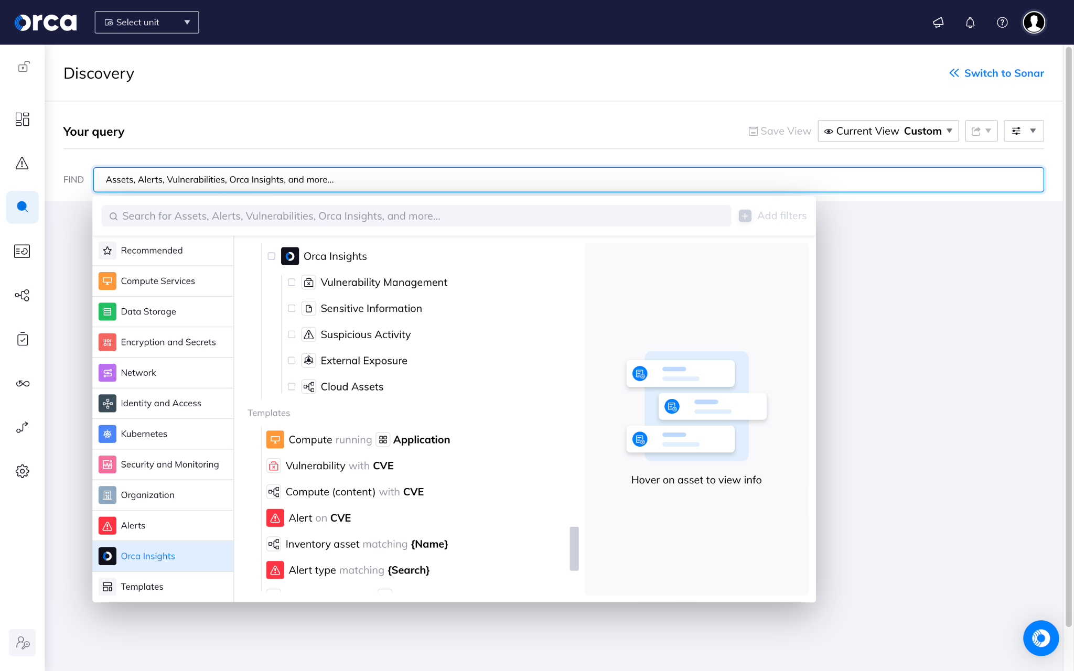
Orca Provides Powerful Cloud Data Security Capabilities
1
2
3
4
Asset Discovery & Inventory:
Cloud risk analysis:
Attack Paths:
Continuous compliance coverage:
Have an extensive view of your cloud inventory, including virtual machines, storage buckets, serverless functions and containers.
Identify, prioritize, and address cloud security gaps, vulnerabilities, and risks.
Understand how dangerous attack paths can be formed through the combination misconfigurations, vulnerabilities, and other cloud risks.
Maintain continuous awareness of compliance gaps and issues that could put compliance status at risk.
Gain comprehensive cloud risk visibility and coverage in a single, comprehensive platform.
Notes:
Orca’s API Security provides organizations with the following capabilities:
Inventory: Have an extensive view of the API attack surface with a continuously up-to-date inventory, without blind spots.
Posture Management: Identify, prioritize, and address API security and compliance risks.
Drift Detection: Identify recently added and deleted APIs and API drift.
All of Orca’s API Security capabilities are included in a single Platform, without the need for additional point solutions such as Vulnerability Management, malware detection, CSPM, cloud workload protection, CIEM, and CDR. The ability for security teams to access all this information from a single platform, greatly reduces learning curves and inefficiencies, and minimizes alert fatigue, allowing teams to instantly understand which risks in your cloud estate are the most pressing.
1. Continuous API Discovery and Inventory
API Security needs to start with full insight into which APIs are running in the cloud environment. After all, how can you protect something you don’t even know about? However, the speed of application development makes it incredibly challenging to keep track of new and changed APIs, or if an API is behaving differently than was intended.
Agent-based solutions struggle to keep up, since they can only see the assets where their agent has been installed. With Orca on the other hand, security teams gain continuous, unparalleled visibility with 100% coverage, and are quickly notified when a new API or service is added by development teams.
Orca’s API discovery is continuous, without the need for time-consuming agents, edge workers, or bringing in a vendor to analyze your logs.
This wide and granular knowledge of your API estate includes the ability to track and analyze all of your API assets, including applications, domains, subdomains, path groups, users, and API endpoints. These include both managed and unmanaged APIs, as Orca is able to extract and analyze data from access logs of both managed (such as AWS API Gateway, Application Load Balancer) and unmanaged gateways (such as NGINX, Apache, and others).
API paths are displayed as an interactive graph with smart labels, allowing you to click on any domain, subdomains and connection to view more data. In this graph, you’ll be able to analyze the workloads, and access logs that are stored within them, to being able to see all API endpoints, requests, and server responses - consolidating all these logs into a coherent map in which you can see your entire API tree structure, and what is being configured and run.
You can do a deep dive into assets and answer questions such as:
What assets are accessible from the Internet, and what APIS / data do they expose?
How many API endpoints contain access to personally identifiable information (PII)?
How are my APIs implemented and connected with other API entities, starting from Applications or Domains?
What are my APIs of a specific Application / Domain / Subdomain?
What are my Application / Domain / Subdomain / APIs with some custom conditions?
Which of my assets are subject to Domain / Subdomain takeover?
Which of my API endpoints has a risk of BOLA exploit?
In addition, screenshots of domains and subdomains provide a real-world picture of a publicly exposed API.
2. API Security posture management
As API usage continues to increase exponentially, and threat actors seek to exploit APIs as an attack vector, Orca enables organizations to take preventive steps to reduce their API attack surface. The API asset data that Orca provides allows security teams to easily and continuously identify, address and prioritize all API risks and configuration-related vulnerabilities. Whether alerting to an API that exposes sensitive data externally, or a subdomain with a recent expiration date, each alert is given a severity score so that teams can prioritize risks accordingly and accelerate mitigation actions.
Alerts include mappings to risks in the OWASP API Security Top 10, for example Broken User Authentication or Security Misconfiguration. You can search the number of risks for a specific severity score, or you can search for the risks associated with a particular domain or subdomain, or alerts over a particular time period.
Each alert, when clicked on, will provide a wealth of information such as alert findings, an alert timeline asset ID, asset ID, cloud account name, a summary of the alert as well as recommendations for mitigation.
These alerts on misconfigurations and vulnerabilities help with compliance as well. Alerts linked to common compliance frameworks such as PCI-DSS help to aid governance and compliance teams to adhere to these frameworks and to stay ahead of audits.
3. API drift detection and management
Orca’s API Security capabilities include a summary of the newly added and removed applications, domains, subdomains, API paths, and API operations on those paths— in the last specified number of days.
But it goes beyond that. Based on specification data collected and analyzed in each API endpoint and related domains and subdomains, Orca generates a Swagger documentation view that can be used to easily compare intended API policy vs. current usage. This helps security teams communicate with their engineering and DevOps teams to ensure that both documentation is updated, as well as facilitate a further understanding of API changes and related risks.

Slide 11
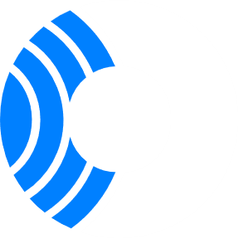
Securing Everything you Have in the Cloud
Cloud Security Posture Management
• Asset Inventory • Compliance Reporting • Continuous Cloud Configuration Assessment
Cloud Infrastructure Entitlement Management
• Entitlement Risk Management & Permissions Analysis • IAM Policies • IDP Integrations
Cloud Workload Protection
• Vulnerability Management • Workload Compliance • Log Inspection • Malware Analysis
Kubernetes Security Posture Management
K8s Benchmarks and Compliance • K8s Control Plane Assessment
Shift Left Security
• Container Image Scanning • IaC Scanning • CI/CD Integrations
Serverless
Data Security Posture Management
• PII Analysis • Exposure Scanning • Asset Inventory
Cloud Detection & Response
VMs
• Attack Path Analysis • Agentless Breach Detection
API Security
Containers
API Inventory • Exposure Identification & Risk Analysis

Slide 12
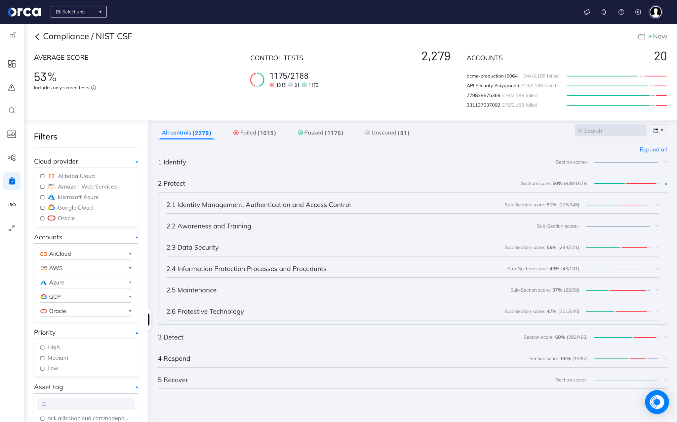
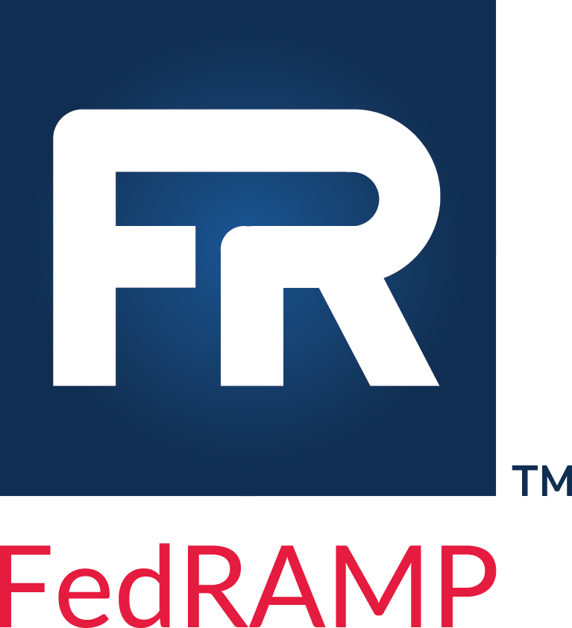
Orca Security for Government
Officially FedRAMP
Ready
Agentless coverage across cloud control plane, data, workloads, and identities
Continuous monitoring and compliance, with pre-built and customizable compliance for top government compliance regimes, including NIST CSF, NIST SP 800-53, ISO 27001, and CIS Benchmarks
Orca’s FedRAMP Platform covers AWS and Azure, with current support for AWS GovCloud and Azure Government

Slide 13
Q & A
Thank you!
Email: public-sector@orca.security
Visit us at: orca.security

